Slide 1
Optimized Deployment of Police Resources in Vancouver Neighbourhoods

Slide 2
Importance of Optimum Police Allocation
Helps in faster police action
Helps in better intelligence gathering
Improves evidence collection and investigation
Enables Police towards a surgical approach
Helps optimize public costs
Makes neighbourhoods safe and secure

Slide 3
Data acquisition and cleaning
Using a real world data set from Kaggle containing the Vancouver Crimes from 2003 to 2019]: A dataset consisting of the crime statistics of each Neighbourhood in Vancouver along with type of crime, recorded year, month and hour.
Gathering additional information of the list of officially categorized boroughs in Vancouver from [Wikipedia]. Borough information will be used to map the existing data where each neighbourhood can be assigned with the right borough.
Creating a new consolidated dataset of the Neighborhoods, along with their boroughs, crime data and the respective Neighbourhood's co-ordinates (fetched using OpenCage Geocoder)

Slide 4
Data acquisition and cleaning
Creating a new consolidated dataset of the Neighborhoods, boroughs, and the most common crimes and the respective Neighbourhood along with co-ordinates.
To explore the neighbourhood crimes and to apply machine learning algorithm to cluster the neighbourhoods and present the findings by plotting it on maps using Folium.

Slide 5
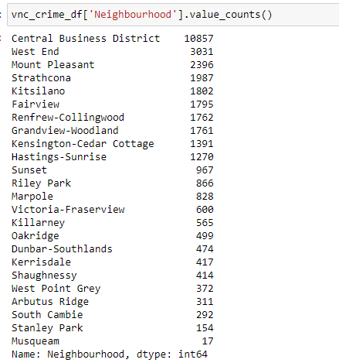
Total Crime Count

Slide 6
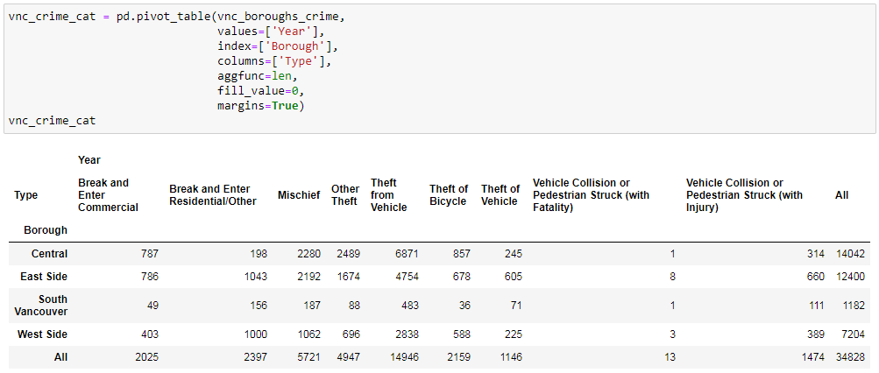
Pivot table (Crimes in boroughs)

Slide 7
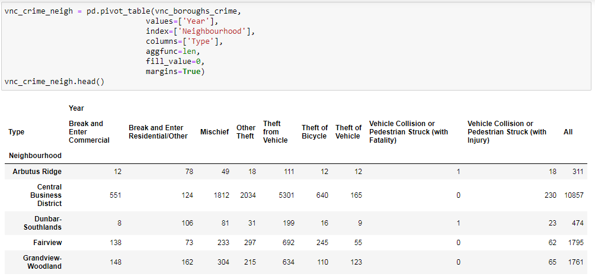
Pivot table (Crimes in Neighbourhoods)

Slide 8
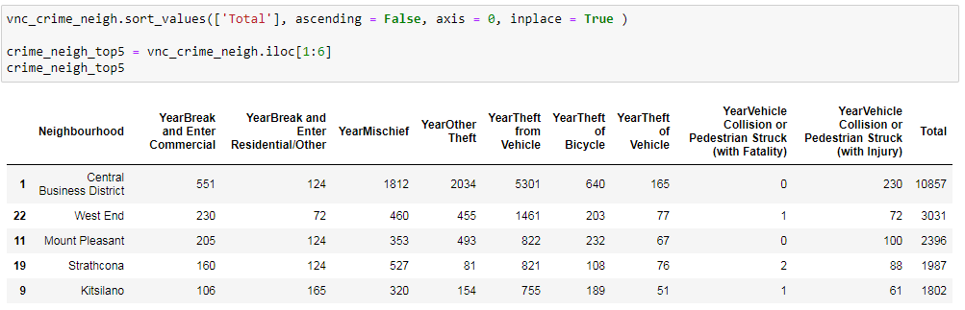
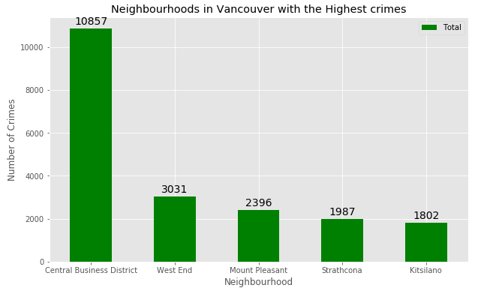
Top 5 Crime-prone Neighbourhoods

Slide 9
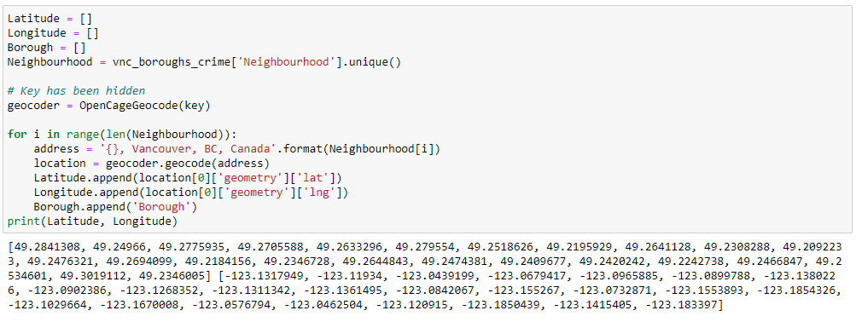
Obtaining coordinates of all the neighbourhoods

Slide 10
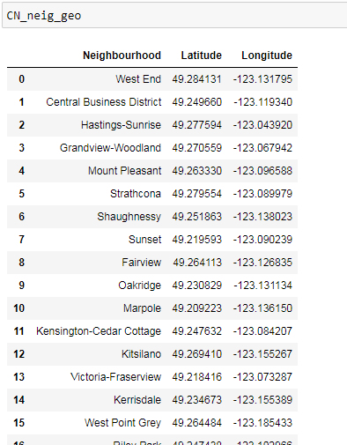
Obtaining coordinates of all the neighbourhoods

Slide 11
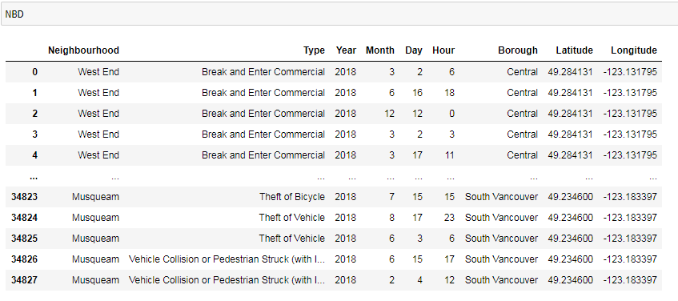
Master table with all the neighbourhood information

Slide 12
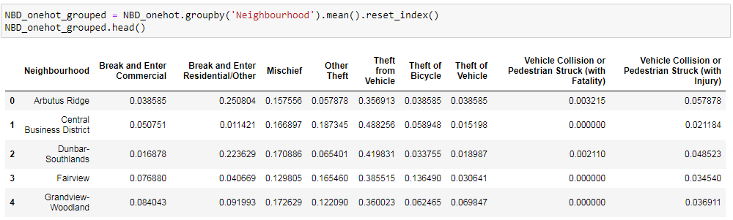
Crime Probability

Slide 13
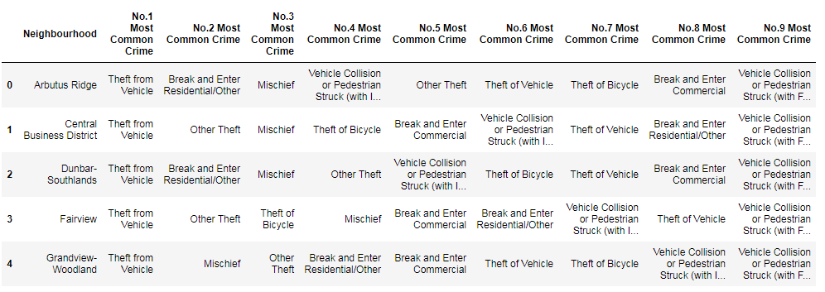
Most committed crimes

Slide 14
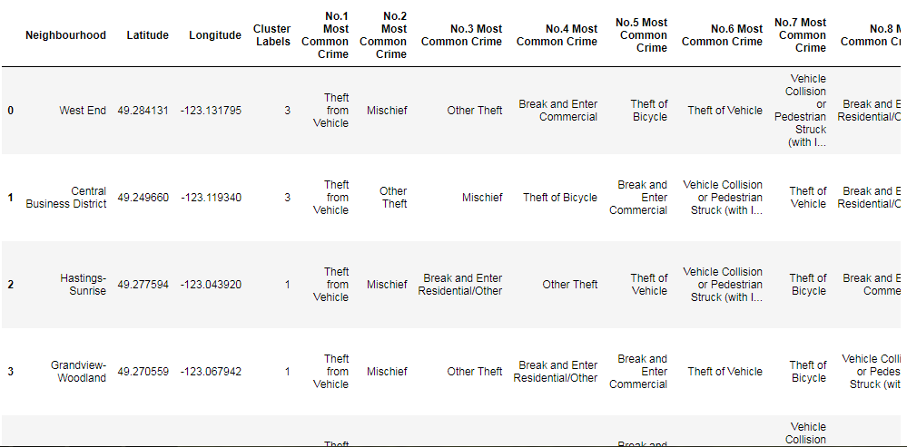
Formation of clusters

Slide 15
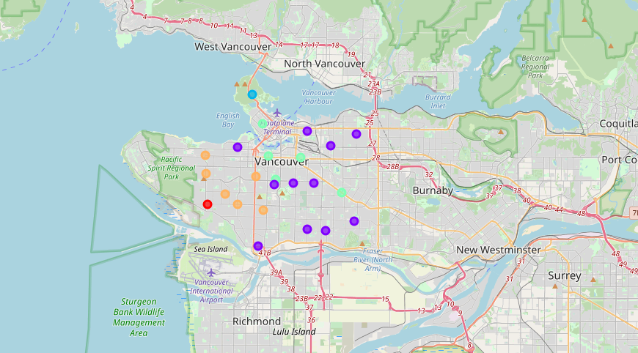
Depiction of Clusters

Slide 16
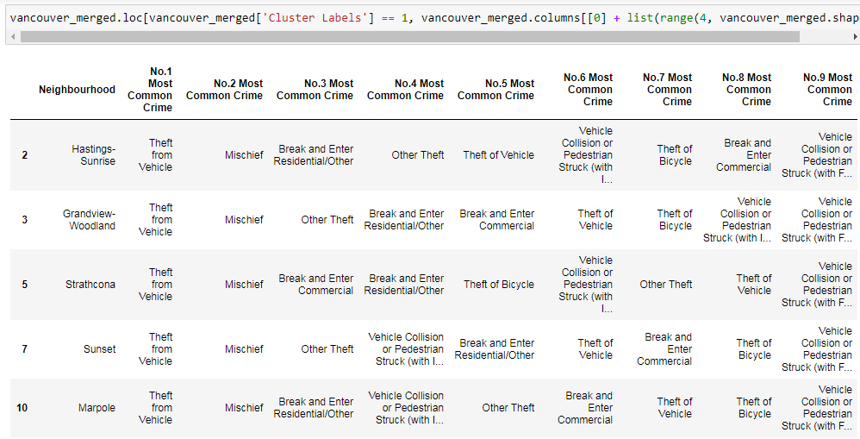
Individual analysis of clusters

Slide 17
Modelling
To help stakeholders choose the right neighborhood within a borough we will be clustering similar neighborhoods using K - means clustering which is a form of unsupervised machine learning algorithm that clusters data based on predefined cluster size.
We will use K-Means clustering to address this problem so as to group data based on existing crimes which will help in the decision making process.
- Defining a function to fetch top 10 crimes around a given neighborhood
- Data frame containing crimes for each neighborhood
- crime Count per neighborhood
- One Hot Encoding to Analyze Each Neighborhood
- Top 5 most frequent crimes across neighborhoods
- Creation of a new dataframe which displays the top 10 crimes for each neighborhood
- Clustering neighborhoods

Slide 18
Results
- Cluster 1 with Musqueam faces the problem of Theft from Vehicle and Break and Enter Residential/Other. Police deployment should be made accordingly
- Cluster 2 has neighbourhood such as 'Hastings-Sunrise', 'Grandview-Woodland', 'Strathcona', 'Sunset', 'Marpole', 'Kensington-Cedar Cottage', 'Kitsilano', 'Victoria-Fraserview', 'Riley Park', 'Killarney', 'South Cambie' and these areas mostly face the problems of Theft from Vehicle, Mischief, and Break and Enter Residential/Other. Police should work accordingly in this cluster.

Slide 19
Results
- Stanley Park is a separate cluster 3 and faces the crimes of Vehicle and Bicycle theft as also Vehicle Collision or Pedestrian Struck
- Cluster 4 comprises 'West End', 'Central Business District', 'Mount Pleasant', 'Fairview', 'Renfrew-Collingwood'. They bear the issues like Theft from vehicle, other thefts, Michiefs, etc. This area thus needs continuous Police patrolling.

Slide 20
Conclusion
We have explored the crime data to understand different types of crimes in all neighborhoods of Vancouver and later categorized them into different neighborhoods, which helped us group the neighborhoods into clusters and deploy police depending upon the frequency of crimes in that particular cluster.

